Slide 1
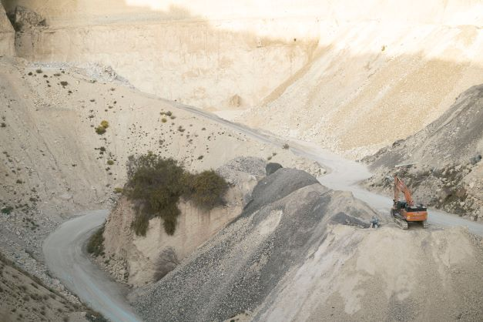
ENV 501 / GR A3 30
Exercise session 2:
Jupyter Notebook tutorial
Teaching assistant:
Jair Campfens jair.campfens@epfl.ch
Fall 2024

Slide 2
Week 2 Exercises
Exercise 1
Compare the 2022 domestic material consumption (DMC) of Switzerland, Japan, and India.
DMC refers to the amount of materials directly used in an economy.
i.e. domestic extraction (DE) + imports – exports
CH: 93.28 million tonnes // JPN: 1185.48 million tonnes // IND: 6984.80 million tonnes

Slide 3
Week 2 Exercises
Exercise 1
How would you interpret these values and/or explain these differences? (consider country demographics, economy and development, decoupling etc.)

Slide 4
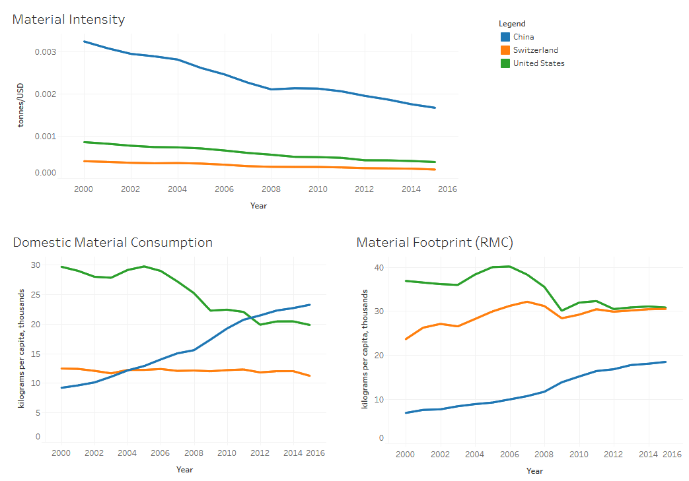
Week 2 Exercises
Exercise 1
2. Considering the GDP and population size, plot the material consumption intensity¹, per capita DMC, and per capita material footprint (i.e. RMC) of Switzerland, China, and the United States from 2007 to 2022.

Slide 5
Week 2 Exercises
Exercise 1
Interpret the trend of these indicators across the years. How would you explain the differences observed among the countries?

Slide 6
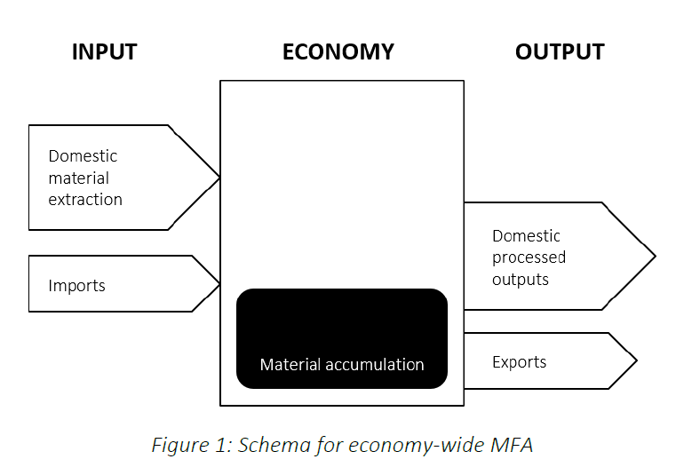
Week 2 Exercises
Exercise 2
Establish the economy-wide MFAs for France, the United Kingdom, and Spain (2022). Consider only the following flows into and out of the economy: domestic extraction of materials, imports, domestic processed outputs, and exports (see Figure 1). Flows within the economy can be ignored.

Slide 7
Week 2 Exercises
Exercise 2
What are the key differences among the countries?
What can you say about the accumulation of material within the economy?
What is the effect of GDP and population size on the results? Is there any evidence of decoupling?

Slide 8
Week 2 Exercises
Exercise 2
2. From your MFA diagrams, calculate the following indicators:
Direct material input (DMI)
DMI = DEU + IMP
FR: 600+326=926
ES: 328+243=571
UK: 453+274=727

Slide 9
Week 2 Exercises
Exercise 2
2. From your MFA diagrams, calculate the following indicators:
Domestic material consumption (DMC)
DMC = DMI - EXP
FR: 926-191
ES: 571-160
UK: 727-150

Slide 10
Week 2 Exercises
Exercise 2
2. From your MFA diagrams, calculate the following indicators:
Physical trade balance (PTB)
PTB = IMP - EXP
FR: 326-191
ES: 243-160
UK: 274-150

Slide 11
Week 2 Exercises
Exercise 2
2. From your MFA diagrams, calculate the following indicators:
Resource productivity
GDP/DMI (million USD/million tonnes)
FR: 2719225/926=2936.5
ES: 1626884/571=2849.2
UK: 2738206/727=3766.4

